Slide 1
Intro to Rails
HILT 2015

Slide 2
Goals
Develop a "Real World" example
Transcription Application
Create, edit, and destroy transcriptions of images
Add user accounts
Deploy in “the cloud”

Slide 3
Meta-Goals
More Ruby syntax
How to go from requirements to a new working Rails application
How to get your application online
The basic tools a Ruby on Rails (RoR) developer uses (source control, editor, console, local server)

Slide 4
What is Rails?
Web application development framework
Write less code, accomplish more
Makes web development “fun”

Slide 5
Rails Principals
Don’t Repeat Yourself (DRY)
Convention Over Configuration

Slide 6
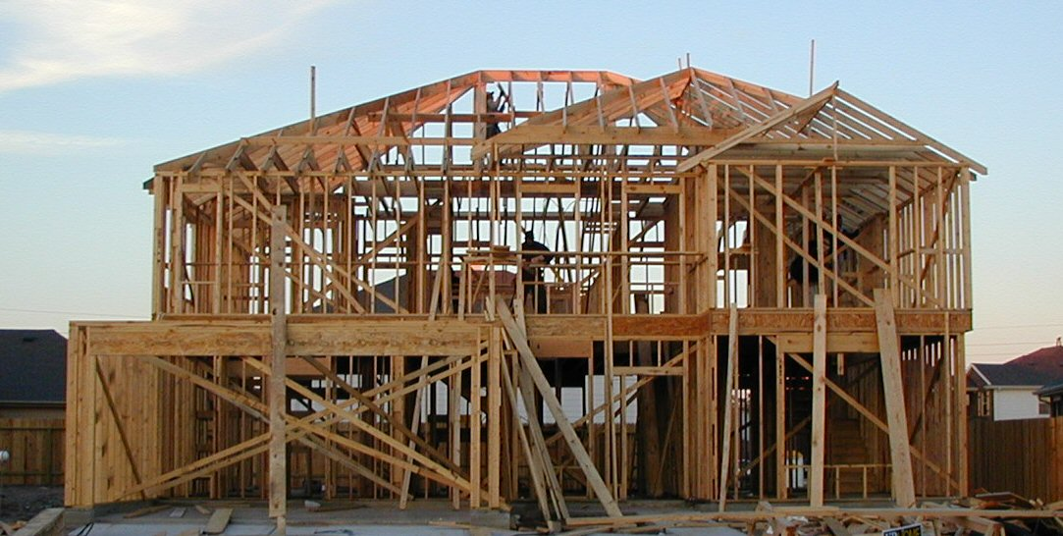
Configuration

Slide 7
Building from Scratch
Making most decisions
Implementing each piece
Pro: control!
Con: Time/Energy
Sinatra (for Ruby)
Flask (for Python)

Slide 8

Convention

Slide 9
Convention
Set up a certain way by default.
Primarily modifying those conventions rather than implementing things from scratch.
Pro: Fast! Easy set up.
Con: Many unknowns. Lots you might not use.
Rails (for Ruby)
Django (for Python)

Slide 10
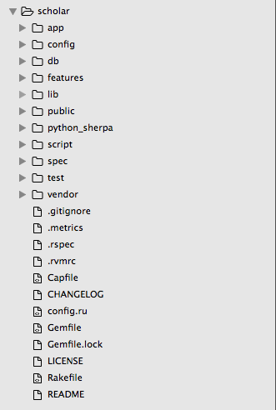
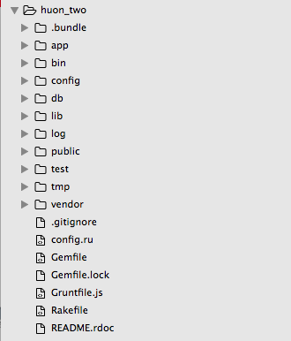
What This Means: Stuff
Notes:
Go over some of the folders.

Slide 11
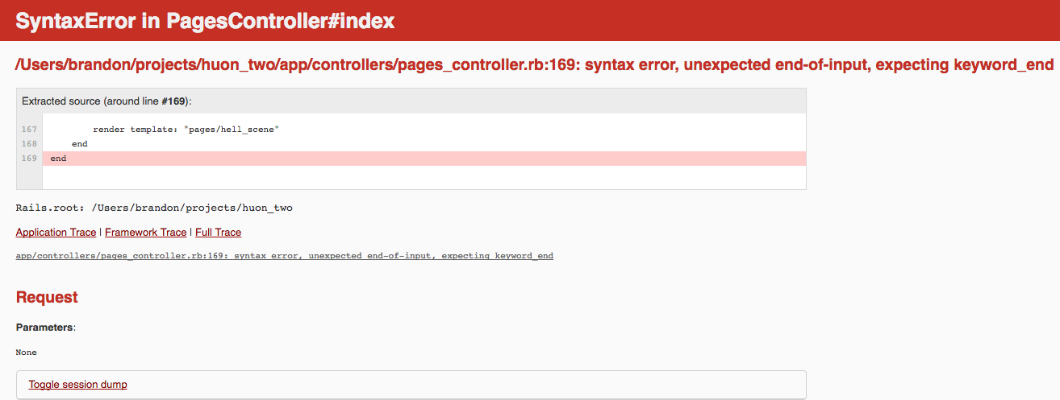
Rails Tries to Help

Slide 12
SO. MUCH. STUFF.
Don’t worry about learning all of it at once.
Operate on an ‘learn as you need it’ principle.
Pick up bit by bit – take it a room at a time.
A few ways in…

Slide 13
Rails Helps!
1) <link href='http://fonts.googleapis.com/css?family=Roboto' rel='stylesheet' type='text/css'>
2) <%= stylesheet_link_tag "http://fonts.googleapis.com/css?family=Roboto" %>
In Rails, 2 will output to 1. 2 is easier to type.

Slide 14
Embedded Ruby
<% some ruby code with no output %>
<%= some ruby code that outputs something %>

Slide 15
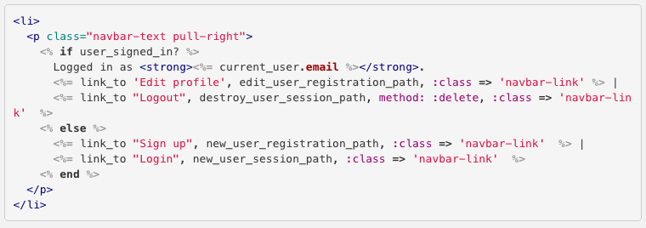
Embedded Ruby in HTML Page
What is going on here?

Slide 16
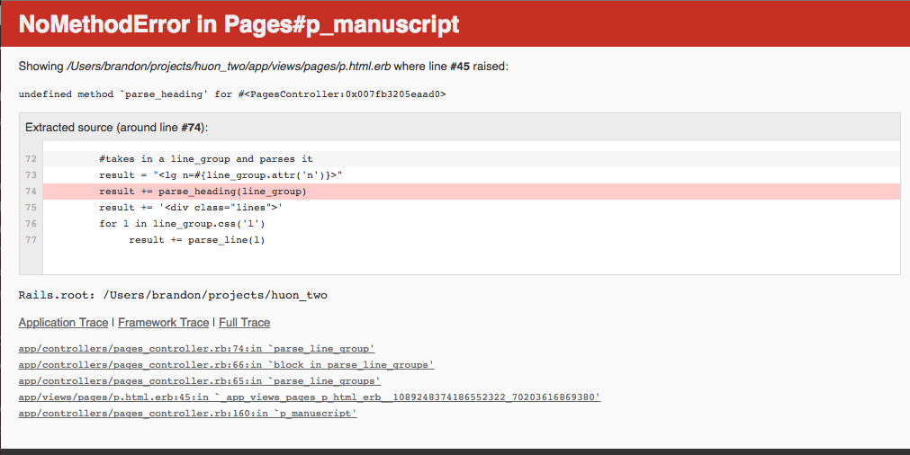

Slide 17
Model View Controller
Way of organizing the parts of your application.
Separates those parts that your user needs from things that need to be secure.
Makes it easier to debug

Slide 18
Model
Describes an Object
Singular name
Can “save” to a database table
Examples: post, user

Slide 19
View
Displays information in human-readable format
Gets information from a controller
Ex. Index view, show view for single post.

Slide 20
Controller
Collects information for a view
Routing determines which controller to use
Can perform different “actions” based on a route
Ex. Update, create, destroy

Slide 21
All Together in Sequence (roughly)
User arrives at webpage, which Rails associates with a…
Controller, which retrieves info from a…
Model, which gives this info back to the…
Controller, which supplies this data to a…
View, which structures and displays everything to the user.

Slide 22
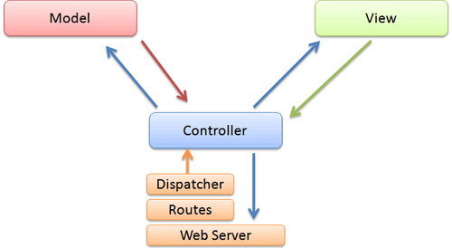
Model View Controller

Slide 23
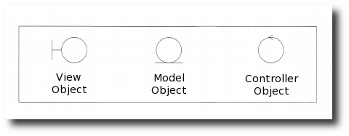
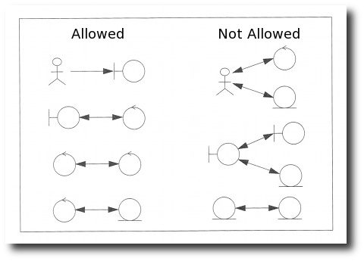

Slide 24
Paint Metaphor (Rough)
Paints: the model
Painter: the controller
Easel: the view
Paint and Easel only ever interact through the painter.
Painter facilitates interactions between both

Slide 25
Affects What You See Where
In models you will see more Rails code
Views are a mixture of HTML and Ruby
Controllers tend to be mostly Ruby

Slide 26
Lots of Other Terminology
Migrations
Mailers
Active Record
Generators
Give yourself time to learn things slowly.

Slide 27
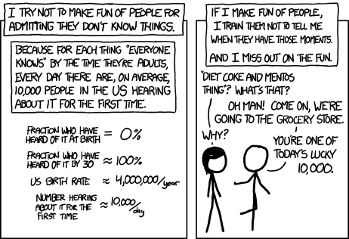
Confused? Good!

Slide 28
Plan of Attack
Move at your own pace.
Type out rather than copy/paste.
Try to understand as much of each line as possible, but don’t sweat details.
Things will break.
We will try to touch base every hour or so for questions.
Use the post-it if you need help!

